Slide 1
Assignment 3: Visualisations in Game Analytics
ANASTASIA BRINATI
BLEKINGE INSTITUTE OF TECHNOLOGY
2023

Slide 2
Methodology:
Choosing an investigation method:
comparing the levels among each other;
comparing areas within a level;
Selecting valuable metrics:
time spent on each level;
time spent on one area of a level;

Slide 3
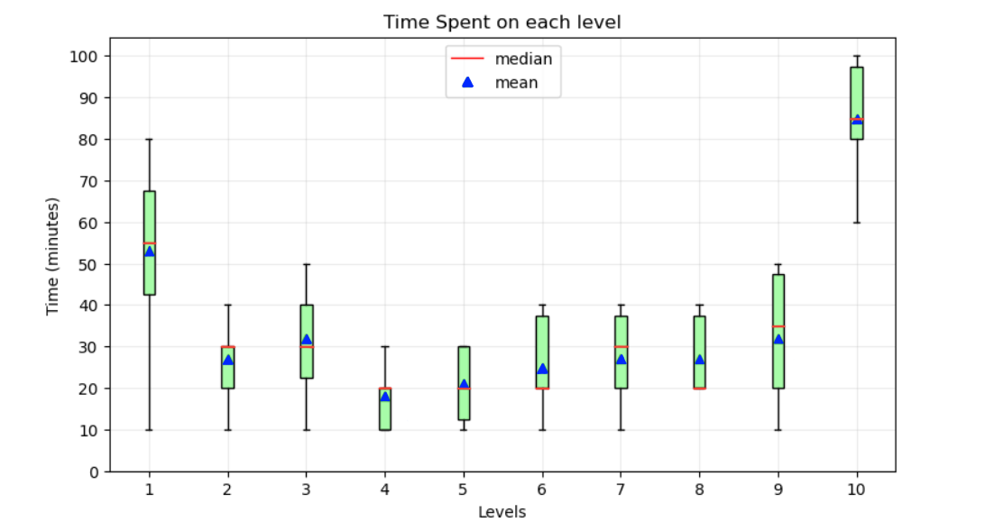
Visualisation 1:

Slide 4

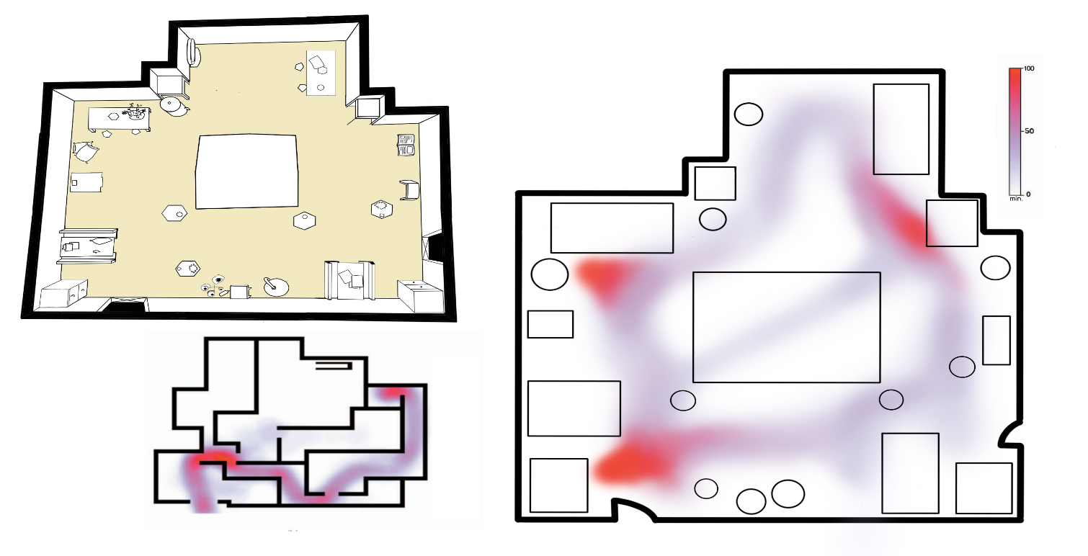
Visualisation 2:

Slide 5
Thank you ☺

